Slide 1
Group 8 Feedback
Group Members:
Sampreet Klair (sklair2@myseneca.ca) - 145031225
Harsahbaj Singh (hsna27@myseneca.ca) - 146457221
Viralika (viralika@myseneca.ca) - 145387221
Arth Indravadanbhai Patel (apatel590@myseneca.ca) - 119100220

Slide 2
User Story
As a business owner, getting feedback from the customers about our services is very important and crucial for sustaining and growing our business.
To help and facilitate, Linda about knowing how her services were from customer’s perspective we have created feedback diagrams which consists of all Class Diagrams (combined), creating customer feedback sequence diagram and querying customer’s feedback sequence diagram.
With the help of our diagrams, Linda will have better customer awareness and would be able to provide better service to the customers.

Slide 3
Reasons why this user story is important:
Better Customer Satisfaction
Competitive Advantage
Informed Decision Making
Useful Actionable Insights
Increased Business Efficiency
Streamlined Feedback Process

Slide 4
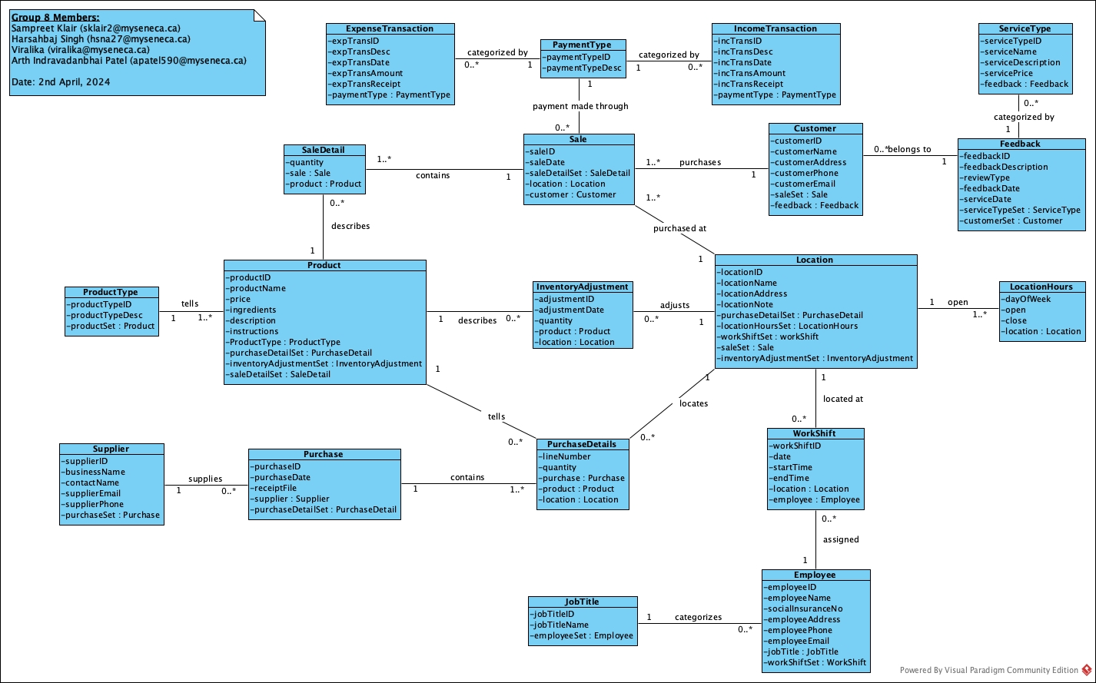
Class Diagram

Slide 5
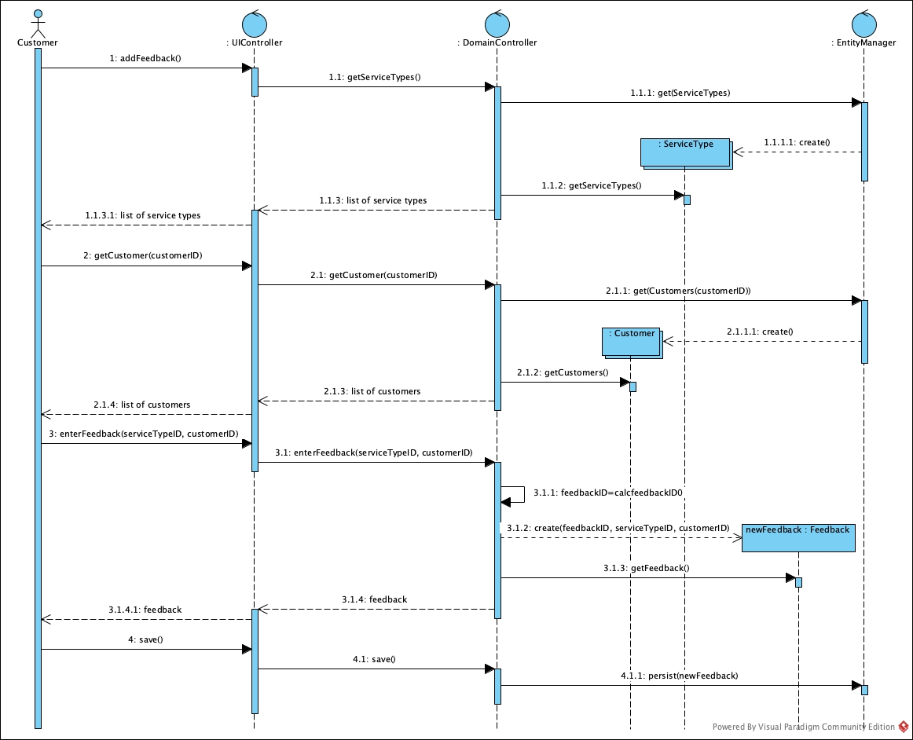
Sequence Diagram for creating a Feedback:
Use Case Description

Slide 6
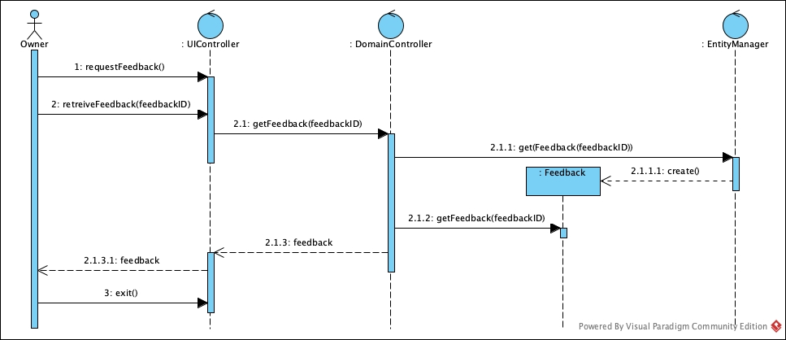
Sequence Diagram for querying a Feedback:
Use Case Description

Slide 7

Thank You…

